Slide 1

Disability Rights Are At Risk:
We Must Act

Slide 2
Agenda
Intro: Who We Are
The Problem: The Issue We Face
Call to Action: Your Voice Matters
Resources: Tools You Can Use
Stay Connected:

Slide 3
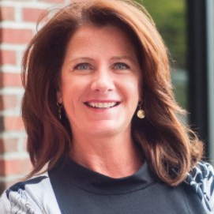
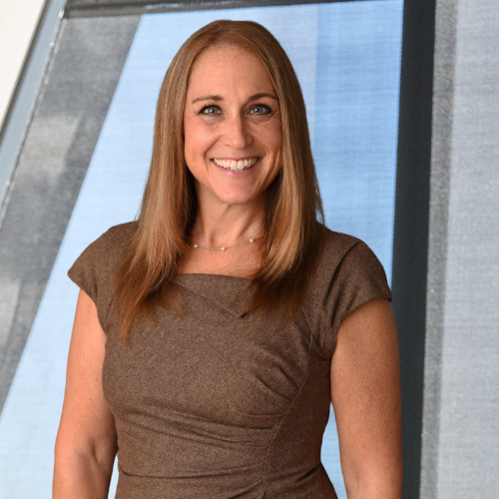
Introductions
Disability Inclusion Advocates
Meg O’Connell, CEO Global Disability Inclusion
Tara Cunningham, CEO Beyond Impact

Slide 4
Before We Begin…
This is a safe space, and it will not be recorded.
We are not lawyers. This is not political discussion.
We will assume positive intentions first on questions that may be asked.
This IS about:
1. disability inclusion and protecting our rights.
2. bringing the community together under one banner.
3. sharing ideas for how to amplify our voices.
4. making sure we have FACTS to share with our networks.

Slide 5
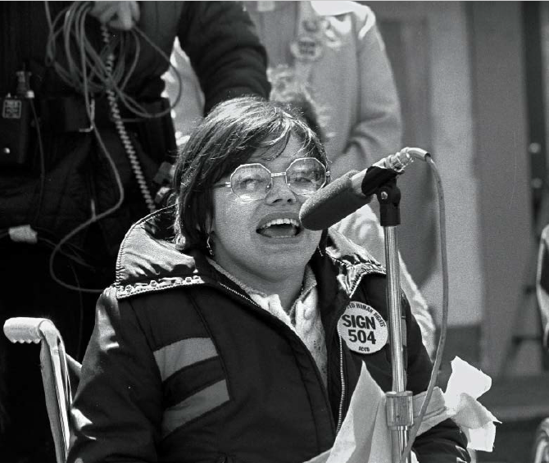
Judy Heumann Quote
“Our anger was a fury sparked by profound injustices. Wrongs that deserved ire. And with that rage we ripped a hole in the status quo.”
― Judith Heumann, Being Heumann: An Unrepentant Memoir of a Disability Rights Activist

Slide 6


Let’s run the numbers.
70M
1.6M
5.2M
40%
People with a disability in the U.S.
Students on a 504 Plan
Veterans in the U.S. have a disability
Seniors -those over 65 have a disability

Slide 7

It began with the DEIA backlash impacting millions of public and private sector employees with disabilities.
The new administration banned Diversity, Equity, Inclusion and Accessibility (DEIA) initiatives citing they were illegal and discriminatory.
All activities related to DEIA must be terminated. This includes policies, practices, programs, preferences, activities – including equity grants and contracts.
Agencies must comply by March 20th.
* A federal judge just issued a preliminary injunction against eliminating DEIA programs, on Feb 21st.
Source: Whitehouse.gov

Slide 8







The Disability Community is facing several challenges impacting our livelihoods, education and healthcare.
Elimination of DEIA Programs impacting recruiting, hiring and retention.
Canceling Employee Resource Groups impacting community at work
Attacks on Medicaid
Massive lay offs in the public sector and beyond.
Threats to Section 504 impact access and quality of care people with disabilities will receive.
Access to mainstream education and risks to special education programs.
Threats to inclusive communities where people with disabilities can engage.
It’s ONLY been a month. We don’t know what is next.

Slide 9
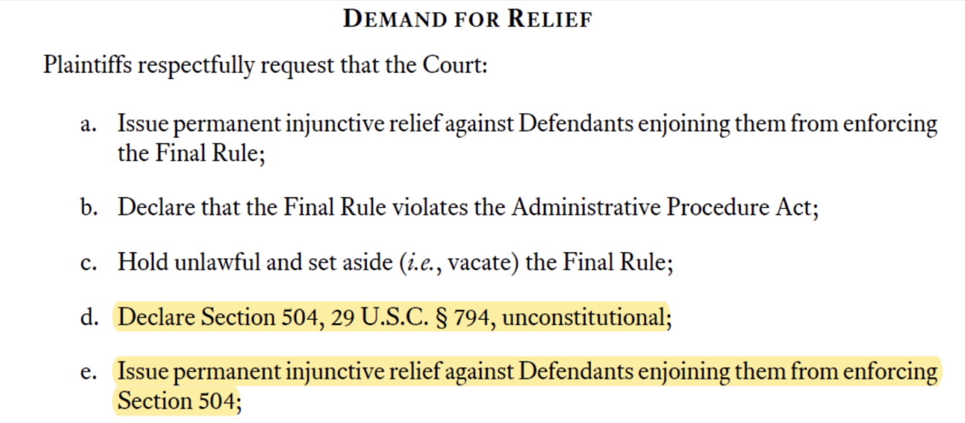
From the case
Source: DREDF.org

Slide 10
Implications for Section 504
Section 504:
Section 504 ensures that discrimination on the basis of disability is illegal.
A lawsuit filed by Texas and 16 other states – (Alabama, Alaska, Arkansas, Florida, Georgia, Indiana, Iowa, Kansas, Louisiana, Missouri, Montana, Nebraska, South Carolina, South Dakota, Texas, Utah and West Virginia) Texas v. Becerra aims to invalidate Section 504 entirely. If successful, this would dismantle protections that ensure disabled students receive accommodations in schools.
Section 504 also ensures access to public facilities – buildings and facilities receiving federal funding MUST be accessible to people with disabilities. This ensures access for employment, education and medical care.

Slide 11
Implications for Medicaid
Medicaid
Proposals to slash Medicaid by $880 Billion over the next decade:
    Institute work requirements or volunteer hours in order to receive Medicaid
    People impacted will be:
    Low income
    People with disabilities relying on long-term care services
    Elderly
    Rural Communities

Slide 12



What can we do? Your call to action.
Contact Your Representative
.
February 28
Economic Day of Protest: No shopping, dining out, online purchases etc..
Get Social
Make a video or social post on why disability rights are important. Use the #NoOneLeftBehind #BeLikeJudy or #DisabilityRights
5calls.org

Slide 13
Get Social!
Create a video about why 504, and/or Medicaid is important to you.
  Keep it less than 30 seconds ☺
Tag your Congressperson and Senator.
Use the hashtags #NoOneLeftBehind and #BeLikeJudy
Tell your friends!!!
This only works if we make a lot of noise!

Slide 14
Any other ideas?
Send us your ideas in Chat!
OR
If you think of something later, email info@nooneleftbehind.us
You’re welcome to email us directly too:
  Meg@globaldisabilityinclusion.com
  Tara@beyond-impact.com

Slide 15
Resources
Organization | Website
Disability Rights and Education Fund | www.dredf.org/protect-504
Medicare Rights Center | www.medicarerights.org
Center for Medicare & Medicaid Services | www.medicaid.org
The People’s Union USA | https://theonecalledjai.com
State Attorney Generals List | U.S. Attorneys | U.S. Attorneys Listing
Educate yourself and others

Slide 16

Thank you
Stay tuned & Keep Informed
www.nooneleftbehind.us (coming soon)
info@nooneleftbehind.us
meg@globaldisabilityinclusion.com
tara@beyond-impact.com

Slide 17


Not Official - Projected Timeline
Week 1: (Feb 26)
Week 3: (March 10)
Week 5 (March 24)
Foundation and Awareness Building
Direct Pressure and Lawmaker Engagement
Community Actions and Policy Push
Start
End
Week 2: (March 3)
Week 4 (March 17)
Sustained Engagement & Long- Term Strategy
Story Amplification and Digital Mobilization
Media and Public Accountability

